Slide 1
Introduction to Software Engineering
Software Process Model (2)
Muhammad Nasir
m.nasir@iiu.edu.pk

Slide 2
Outline
Evolutionary Process Models
  Prototyping
  Spiral Model
  Component based development (CBD)

Slide 3
Evolutionary Process Model
A process model that has been explicitly designed to accommodate a product that evolves over time.
Produce an increasingly more complete version of the software with each iteration.
Evolutionary Models are iterative.
Evolutionary models are:
  Prototyping
  Spiral Model

Slide 4
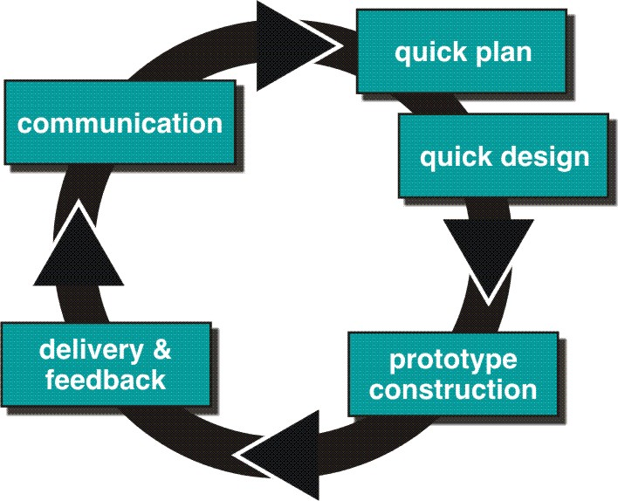
Evolutionary Process Models: Prototyping

Slide 5
Prototyping (cont..)
Often, a customer defines a set of general objectives for software, but does not identify detailed requirements for functions and features.
In this case Prototyping is best suited
Prototyping can be used together with other models for elicitation of requirements
The prototype can serve as “the first system.”
Some prototypes are “Throw Away” while others also evolve and become part of the actual system

Slide 6
Prototyping (cont..)
Both customers and developers like the prototyping paradigm.
  Customer/End user gets a feel for the actual system
  Developer get to build something immediately.
Problem Areas:
Developer often makes implementation in order to get a prototype working quickly without considering long term maintainability and Quality, efficient algorithms etc.
Customer cries foul and demand that “a few fixes” be applied to make the prototype a working product, due to that software quality suffers as a result.
Customer and developer both must agree that the prototype is built to serve as a mechanism for defining requirement.

Slide 7
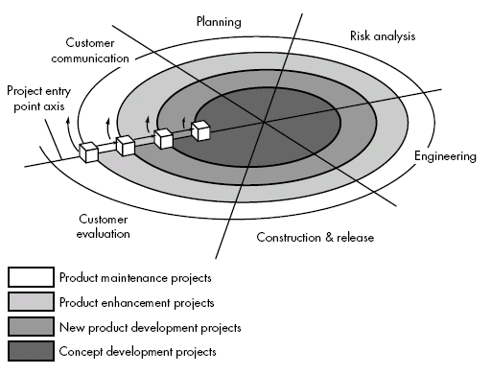
Spiral Model

Slide 8
Spiral Model
Combines iterative nature of prototyping with the controlled and systematic aspects of the linear sequential model
Using spiral, software developed in as series of evolutionary release.
  Early iteration, release might be on paper or prototype.
  Later iteration, more complete version of software.

Slide 9
Spiral Model
Evolutionary process begins in a clockwise direction, beginning at the center risk.
First circuit around the spiral might result in development of a product specification. Subsequently, develop a prototype while progressively constructing more sophisticated version of software.
Unlike other process models that end when software is delivered.

Slide 10
Spiral Model (cont.)
Concept Development Project:
Start at the core and continues for multiple iterations until it is complete.
If concept is developed into an actual product, the process proceeds outward on the spiral.
New Product Development Project:
New product will evolve through a number of iterations around the spiral.
Later, a circuit around spiral might be used to represent a “Product Enhancement Project”
Product Enhancement Project:
There are times when process is dormant or software team not developing new things but change is initiated, process start at appropriate entry point.

Slide 11
Spiral Model (cont.)
The spiral model uses prototyping as a risk reduction mechanism.
It maintains the systematic stepwise approach suggested by the classic life-cycle
But incorporates it into an iterative framework that more realistically reflects the real world.
The spiral model demands a direct consideration of technical risks at all stages of the project

Slide 12
Spiral Model (cont..)
Problem Area:
It may be difficult to convince customers (particularly in contract situations) that the evolutionary approach is controllable.
It demands considerable risk assessment expertise

Slide 13
Specialized Process Model
Specialized process models take on many of the characteristics of one or more of the traditional models presented in the preceding sections.
However, these models tend to be applied when a specialized or narrowly defined software engineering approach is chosen.

Slide 14
Component Based Development Model
Commercial off-the-shelf (COTS) software components, provide targeted functionality with well-defined interfaces
that enable the component to be integrated into the software that is to be built.
The component-based development model incorporates many of the characteristics of the spiral model.

Slide 15
CBD (Cont…)
1. Available component-based products are researched and evaluated for the application domain in question.
2. Component integration issues are considered.
3. A software architecture is designed to accommodate the components.
4. Components are integrated into the architecture.
5. Comprehensive testing is conducted to ensure proper functionality.

Slide 16
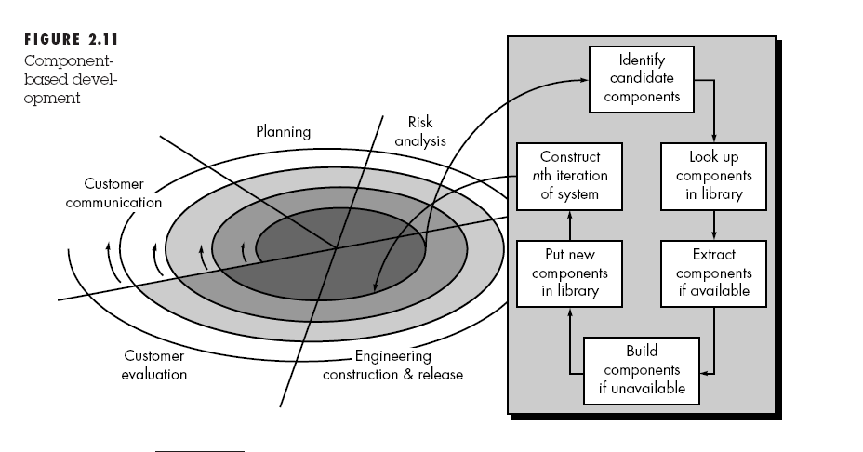
Component Based Development Model

Slide 17
CBD Model (cont.)
The component-based development model leads to software reuse, and reusability and a number of measurable benefits.
Reduction in software development cycle time as well as
Reduction in project cost

Slide 18
The End
Thanks for Listening
Questions & Answers

